Slide 1
Analyzing Amazon Sales data
Submitted By
BETTEENA THANKACHAN

Slide 2
Table of Contents
01
02
03
04
DATA USED
PROBLEM STATEMENT
OUTPUT
CONCLUSION

Slide 3
01
PROBLEM STATEMENT

Slide 4
PROBLEM STATEMENT
Sales management has gained importance to meet increasing competition and the need for improved methods of distribution to reduce cost and to increase profits. Sales management today is the most important function in a commercial and business enterprise.

Slide 5
02
Data Used
You could enter a subtitle here if you need it

Slide 6
DATA
Name:Amazon sale
The Amazon sales data contains 100 rows and 14 columns. It includes information such as Region, Country, Item Type, Sales Channel, Order Priority, Order Date, Order ID, Ship Date, Units Sold, Unit Price, Unit Cost, Total Revenue, Total Cost, and Total Profit. The data captures various sales transactions across different regions and product categories, both online and offline, with detailed financial metrics for each transaction.

Slide 7
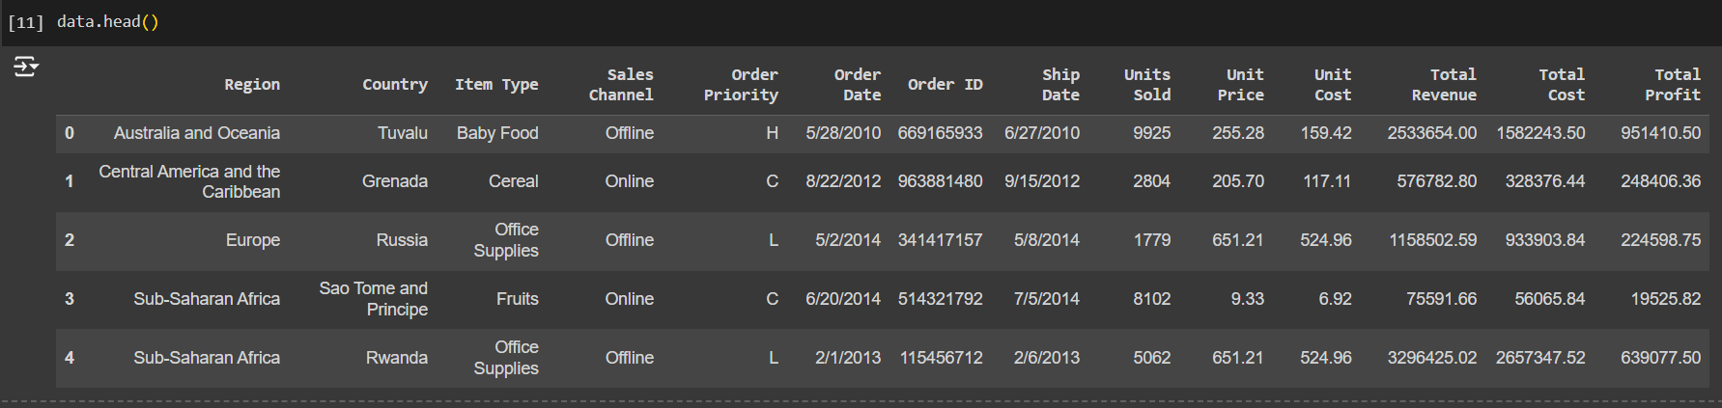
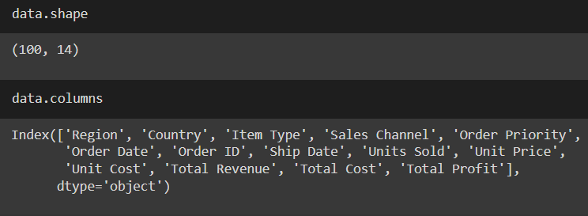
DATA

Slide 8
03
OUTPUT

Slide 9
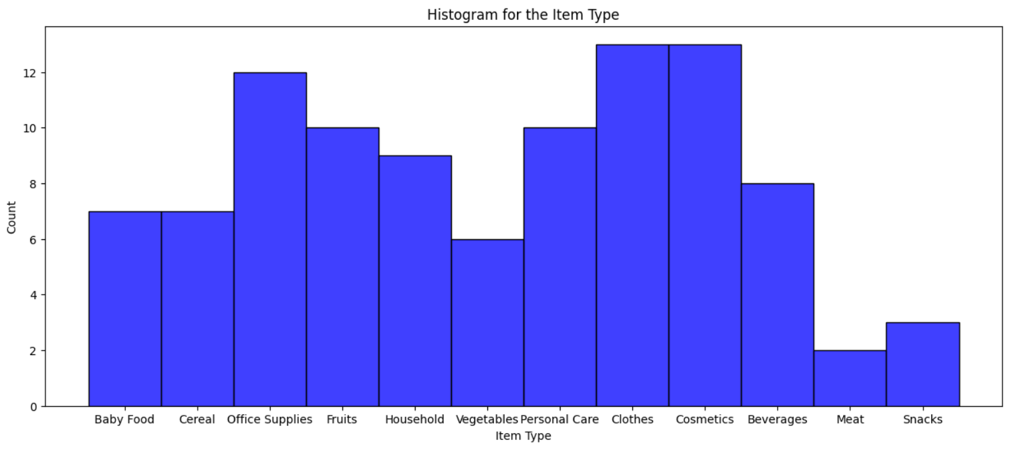
ITEM TYPES

Slide 10
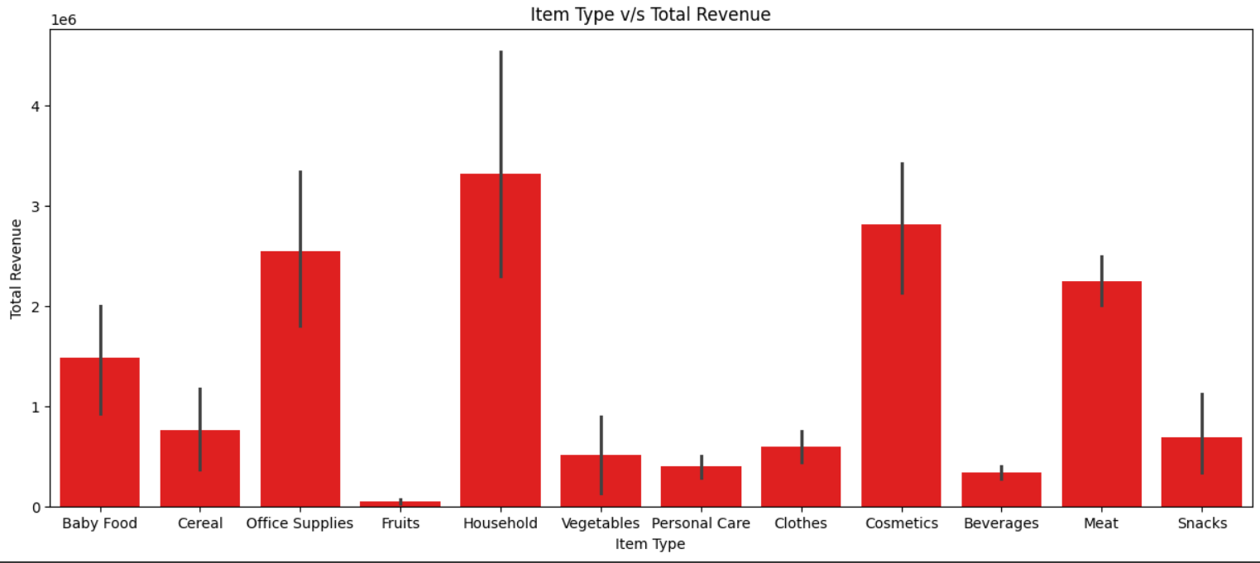
ITEM TYPES v/s TOTAL REVENUE

Slide 11
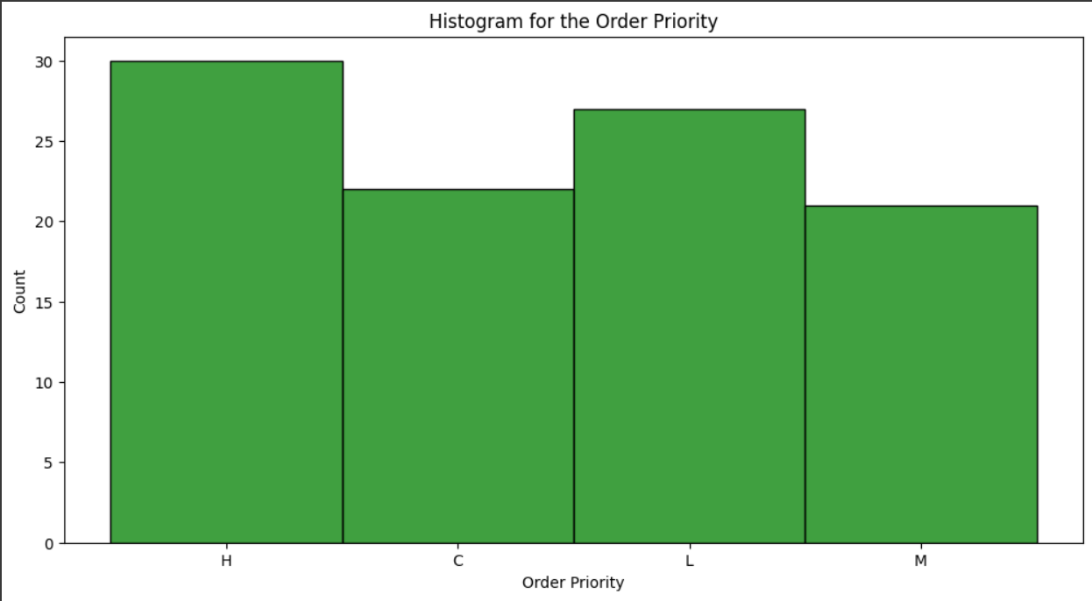
ORDER PRIORITY

Slide 12
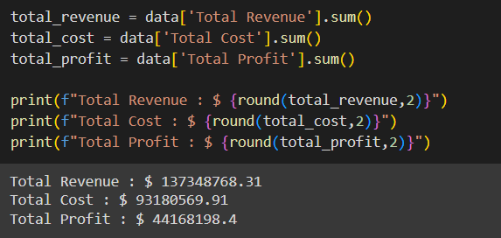
KEY METRICS

Slide 13
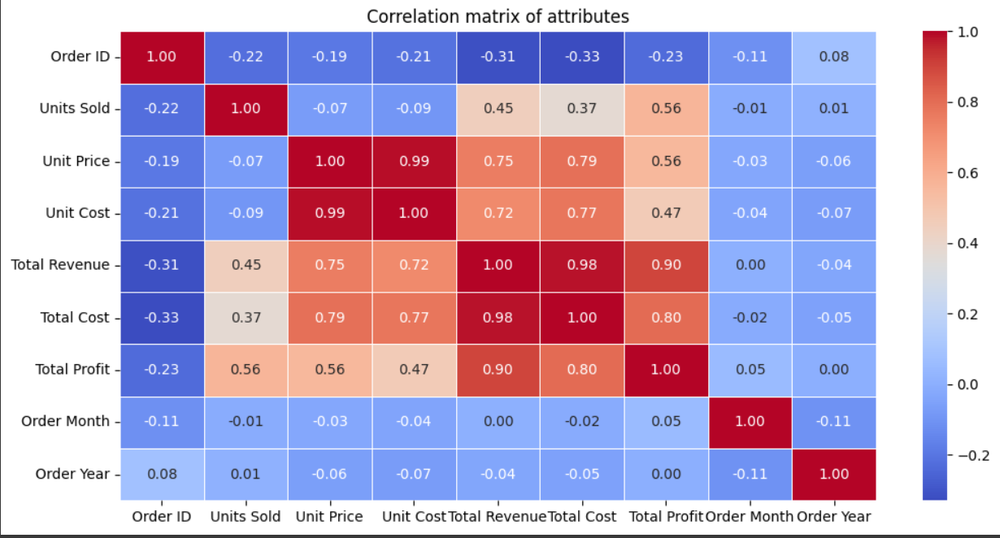
Correlation of Attributes

Slide 14
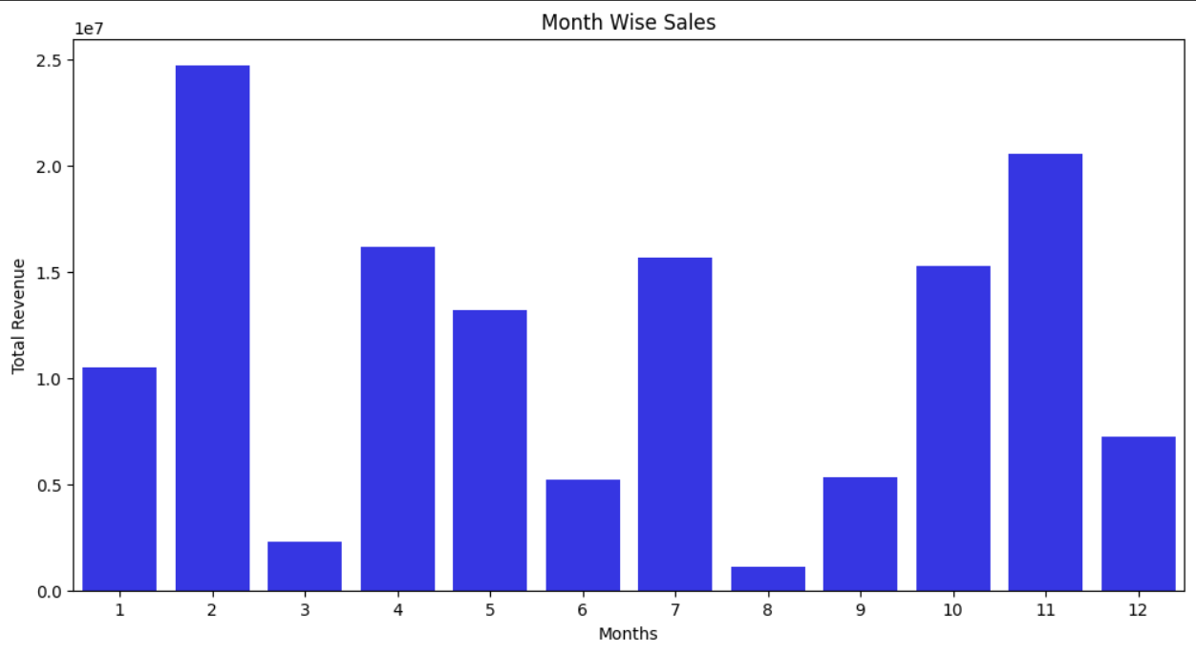
MONTH WISE SALE

Slide 15
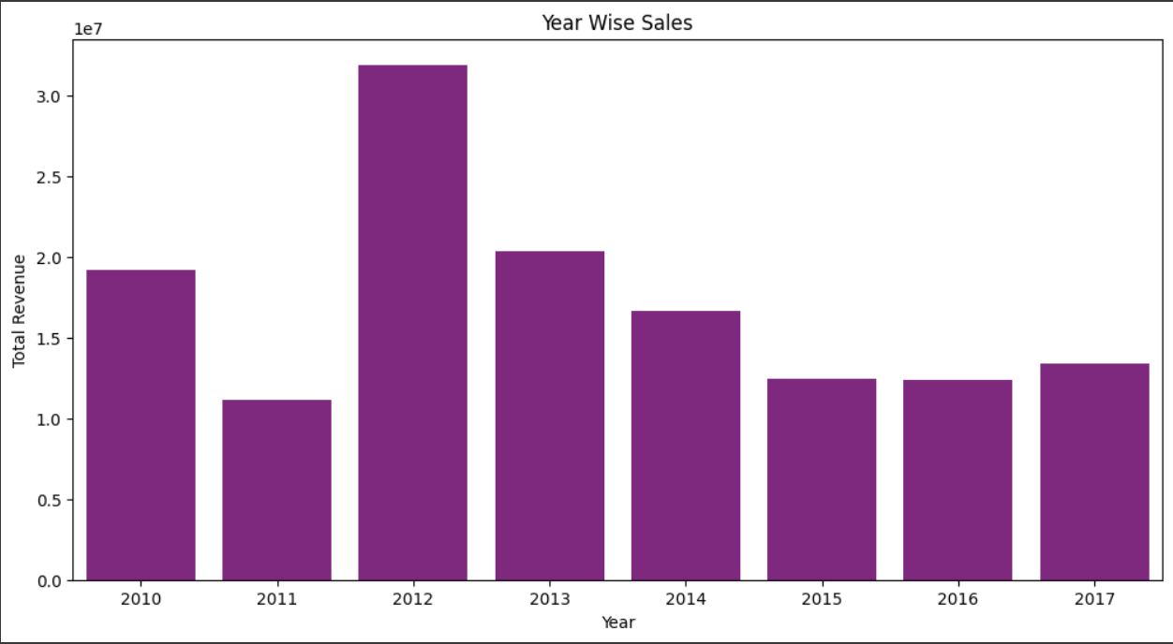
YEAR WISE SALE

Slide 16
YEAR WISE SALE

Slide 17
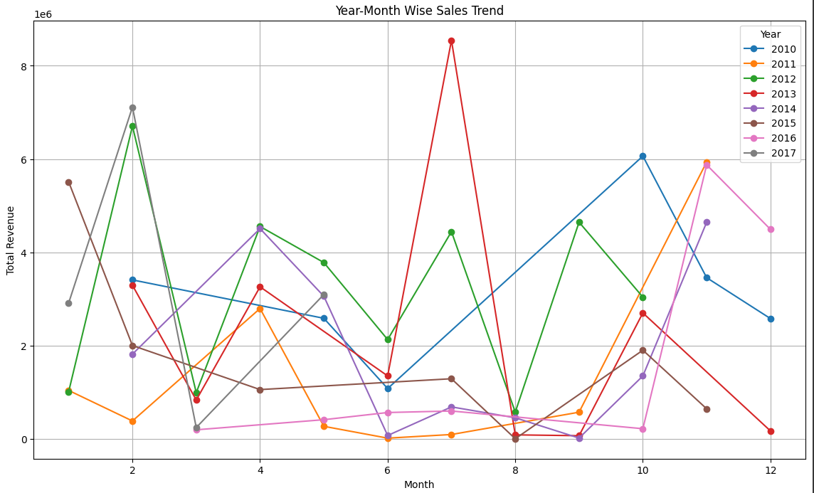
Marketing Mix 6 P’s

Slide 18
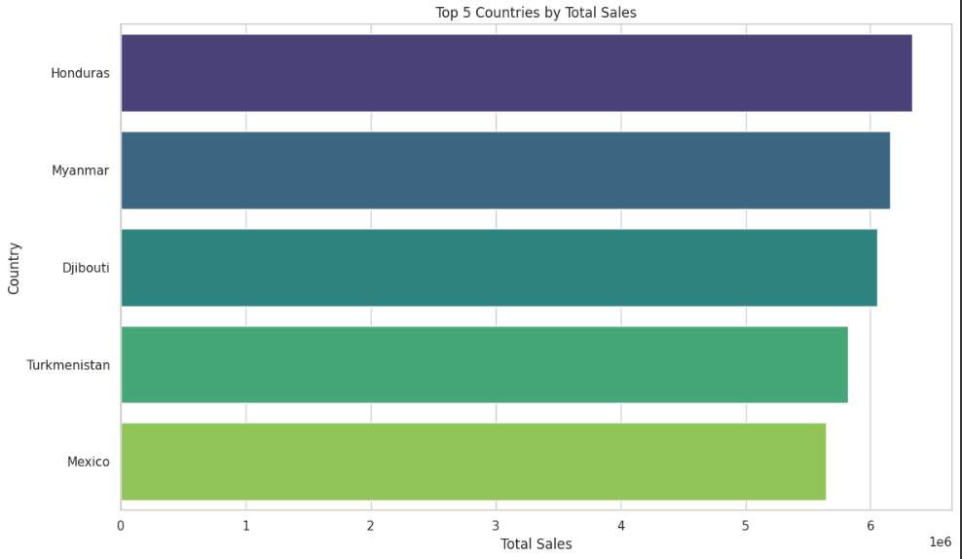
TOP 5 COUNTRIES BY TOTAL SALES

Slide 19
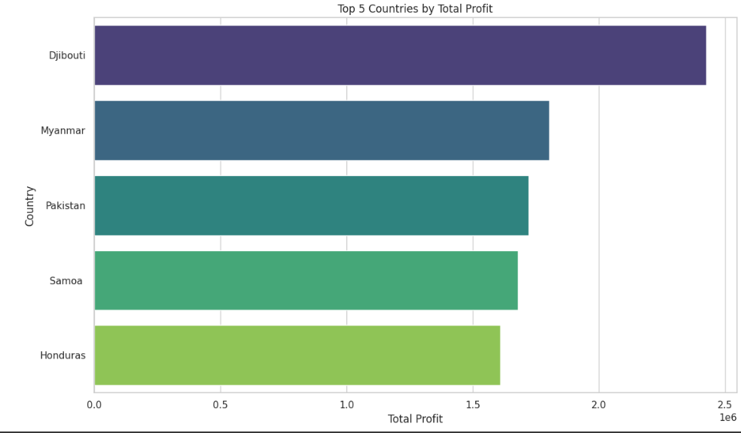
TOP 5 COUNTRIES BY TOTAL PROFIT

Slide 20
RESULT
Item Types:
Most sold items: Clothes and Cosmetics.
Highest revenue: Household items.
Lowest revenue: Fruits.
Order Priority:
Highest number of orders marked as 'High' priority, indicating a trend towards urgent deliveries.
Sales Trends:
Monthly: February has the highest sales, August the lowest.
Yearly: 2012 recorded the highest sales, showing significant growth from 2011.
Year-Month: Peak sales in July 2013; lowest in August 2015 and September 2014.
Financial Metrics:
Total Revenue: $137,348,768.31
Total Cost: $93,180,569.91
Total Profit: $44,168,198.40
These results provide a comprehensive understanding of sales distribution, product performance, and financial outcomes, supporting strategic business decisions.

Slide 21
04
CONCLUSION

Slide 22
CONCLUSION
The dataset of 100 sales records shows that Clothes and Cosmetics are the most sold items, Household items generate the highest revenue, sales are equally online and offline, and high-priority orders dominate. February has the highest sales, August the lowest, with peak sales in July 2013 and overall highest sales in 2012. Total revenue is $137M, cost $93M, and profit $44M.

Slide 23
Sales Employees
Account Manager
Venus has a beautiful name and is the second planet from the Sun
Sales Representative
Despite being red, Mars is actually a cold place full of iron oxide dust
Sales Manager
Saturn is a gas giant, composed mostly of hydrogen and helium

Slide 24
Thanks!

